Slide 1
Moving from Surviving to Thriving: Out of the Life Raft & Steering the Yacht
Jess Clayton
October 2024 ICSEW Professional Development Conference

Slide 2
Workshop Outcomes
At the conclusion of this workshop, you will
Know how to leverage your personal story overcoming adversities and roadblocks
Understand how to strategically navigate the 4 steps of bringing diversity, equity, access, inclusion and belonging (DEAIB) into your professional role
Apply the steps for a current desired outcome in your state service role

Slide 3
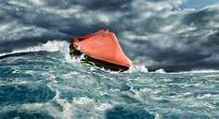
My Story
Notes:
{Copy of Bio} Jess Clayton, MSW, is a trans, queer, physically disabled, kidnapped, sex-trafficked and severely abused cult survivor and victim of domestic violence career state employee who leverages their experiences in strategically serving others to propel the pro-equity, anti-racism work forward with greater momentum. Jess holds 26 years of experience working with marginalized populations in behavioral health, chemical dependency, social services, child welfare, and healthcare management with 18 years in public administration and public health policy and 16 years leading public sector strategic change management. A member of two of the Washington State Business Resource Groups (Rainbow Alliance Inclusion Network and Disability Inclusion Network), they are deeply passionate about social and health equity, particularly as it relates to providing equitable access to needed programs and services for the most vulnerable populations. They enjoy developing strategic and varied partnerships and resources, building and promoting diverse teams where each individual member feels valued for their unique insights, perspectives, expertise, and opinions, working in unity towards a common, definable goal and pushing the boundaries of those same systems to realize their full potential and capabilities through innovation and creativity.

Slide 4
Rechargeable Self-Confidence
"Quiet," by Milck
"Fight Song," by Rachel Platten
Notes:
Like all humans, I had to find ways to regularly recharge my self-confidence as a critical part of my journey. Fleeing everything I knew, embarking in a world largely foreign to me and without any local support network, having to build my life essentially from the ground, up, that late in my life and with my level of medical complexities and disabilities – then essentially re-doing it all again just two years later at the cusp of losing one of my biggest supporters, my adoptive mom. Trust when I say there were plenty of times I questioned myself!
Through all of this, music helped shape my vision of a better future for me. I’m a strong believer in the power of music. It has the ability to cut through emotional numbness and establish an openness to human connection that might not otherwise be achievable. It would’ve been easy to shut down, close myself off, and become a shell of the person I was becoming. There were days I played certain songs on repeat, just to make it through the day. I’d like to share with you two songs in particular which helped me the most in those times, before we take our 5-minute break. These songs provided me that seed of self-confidence to navigate the rough waters ahead and gave me a voice to be heard above the thunderous waves.
[Play songs]

Slide 5
BREAK
Return in 5 minutes

Slide 6
Life Raft
Used in an emergency
Small, lightweight, buoyant platform
Open to the elements
Made of plastic, rubber, or wood
Designed for use by people forced into the water
Merely for safety until help arrives – not intended as a long-term solution
Notes:
Concept of, “Who do I allow to share my life raft?”: You’re trying to survive in a life raft, navigating rough waters and storms, completely exposed and at the mercy of the elements.
Do you want to be sharing that space with people who are helping you paddle, moving towards something better, something stable?
Or do you want to share the raft with people who are busy drilling holes into it?

Slide 7
Yacht
Able to handle rougher ocean waves
Equipped with advanced navigation and guidance instruments
Holds a full crew helping with the navigation, engineering, repairs, and stewards to serve guests
Luxury vessel designed for leisure
Notes:
Imagery of moving not simply from survival to stability, but taking it even further to steering the yacht:
Empowering you towards intentionally guiding your own life and leading in state service as someone who gained expertise through navigating your own adversities and roadblocks – then taking it one step further bringing diversity, equity, access, inclusion and belonging (DEAIB) into your professional role.

Slide 8
Step 1: Mapping the Course
Define known and anticipated roadblocks and adversities hindering your success: in your life and your state service
Once they’re defined, they’re known.
Once they’re known, they’re manageable.
Break these down into their details.
Define individual aspects which must be addressed:
Mountains = rocks, dirt, trees, animals present, etc.
Notes:
Leaping to the yacht is scary. Break each down into the pieces of what’s really standing in your way. Focus first on those barriers that are currently the most urgent or pressing issue – and the ones you most want to strategically navigate or overcome.
Be careful to not join those folks drilling holes in your life raft by focusing on roadblocks that aren’t happening and do not need your attention for you to avoid them. Make your leap to the yacht: Go ahead and plan for known and anticipated barriers that do need your navigation to avoid, or which are inevitable based on others’ choices.
Recognize that as your journey begins – as you leave the life raft mentality and begin planning the yacht’s course – you may come across barriers that weren’t known or anticipated. Use your rechargeable self-confidence tools, take a breath, then repeat this step. Remember that you only need to address new roadblocks as they arise or become inevitable. Not before that.
Often, you’ll find that “new” roadblocks are not far from things you already anticipated or that they have similar elements to ones you’ve already defined. Breaking these down into their details and examining their individual aspects which much be addressed makes it easier to recognize similarities to ones you’ve already overcome or have plans around. This empowers you to preserve your energy when managing a roadblock or adversity you’ve already planned around, and keeps you grounded on your yacht.

Slide 9
Step 2: Fueling Your Tank
Finding your why for the effort
Use your superpower!
Record your Why as if it’s already true.
Establish refueling capabilities with a crew: Your support network.
Notes:
This is where your individual superpower enters the scene. Your unique, lived experiences with diversity, equity, access, inclusion and belonging: What you have personally lived through, witnessed, or wished was handled differently – and what you want things to be in the future.
Remember, you’re now the one steering the yacht, directing your crew of helpers.
How do you do that?
I guarantee that all of you have experiences you’ve either been part of or witnessed where diversity, equity, access, inclusion, or belonging was Not welcomed or the reality in that moment with the individuals and systems involved.
You’ve been part of some of those and you’ve witnessed others. Think of those situations, your interactions in those – or lack of intervention – and flip the script to what that might look like if a diverse, anti-racist, pro-equity, full access and accessibility, calling-in, inclusive and sense of belonging space existed in that moment instead.
Visualize what that future state looks like. And then Record It as if it Already Exists! This is the WHY for your effort.
Why record it:
When you hit the rough waters and storms while trying to navigate through the most difficult barriers, when morale for yourself and your crew is low and you’re operating on few resources and little sleep – That’s when you need your vision of the future the most.
The reminder of that shared vision and realization of how much closer you and your crew are to it than when you first started puts fuel in your tanks to keep moving forward, to Choose to keep moving forward, and propel your efforts.
Why recording it as if it already exists:
When you’ve recorded your Why as if it already exists, it’s much easier to recognize how much has already been achieved during the journey.
If you record your Why as some sort of future-state, it becomes a “maybe” – you lose the commitment to making it happen. It always remains a far-off future goal, a dream rather than a vision, and not something you are actively working to make a truth.
Example:
You will go grocery shopping, do the laundry, and clean the bathrooms. (this is a future-state kind of statement)
Versus: You have a fridge and pantry full of food, clean clothes hung nicely in their bedroom closet, and sparkling clean bathrooms.
Which statement feels like a to-do list? Which one feels inspiring?
If you want your yacht to have fuel and capabilities to continually refuel even in the toughest times, record your why AS IF IT’s ALREADY TRUE.
To those who like to jump from defining the barriers straight into problem-solving:
Pause to learn from yourself. Not wanting to stop to determine your why for the effort is often a signal there’s some personal work to be done first. Perhaps some personal healing needing to take place before you’re ready to envision the future state of something that relies on having that healing work done.
Our hurts and grief and loss and shame can run real deep sometimes, and we can want to distract ourselves with the good work and service to others so that the “noise” from others’ recognition and praise can drown out those uncertainties or traumas or guilt within ourselves.
Some part of you is likely still on the life raft where someone is drilling holes. Ignoring that part of you may mean you’re towing unnecessary baggage instead of bringing your full self to the yacht.
Take tendencies to jump from problem to solution without considering your Why for effort as great educators, informing you there’s personal work to be done here. Use your support network – even if you have to build one from scratch repeatedly. Do that personal work. Decent support networks can include a counselor you trust to help you do that personal work.
Support networks provide you the capabilities to continually refuel during your journey. Your support network can include online communities, too, not just folks you’re able to be around in person. Get any personal work done using your support network, even if it’s while you’re doing pro-equity anti-racism, diversity, access, accessibility, inclusion, or belonging work in state service so that your full self is there, present on the yacht, your tank is fueled, and you’ve got the capabilities to continually refuel your tank.

Slide 10
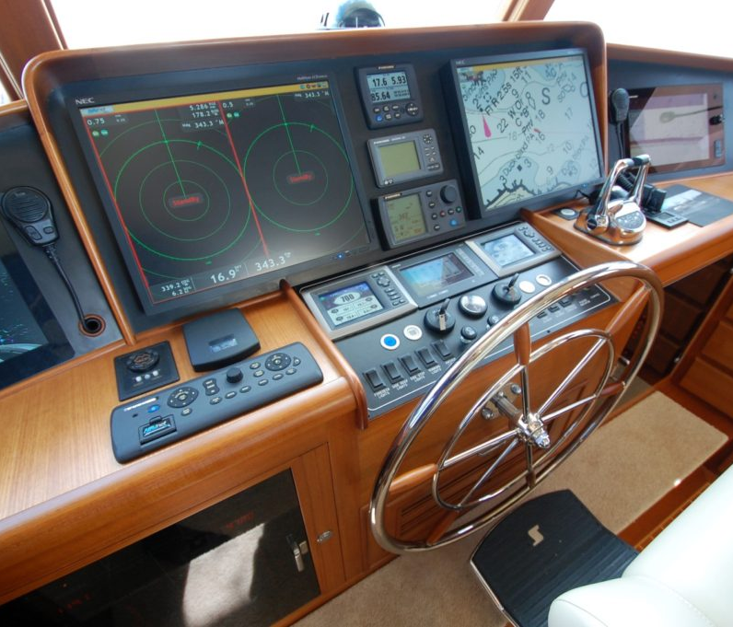
Step 3: Applying Advanced Navigation
Determining the best path forward
Chart the most fuel-efficient course, given the barriers and ocean you’re traversing.
Leverage your superpower to apply your unique knowledge and experience to your strategy.
Pause to celebrate along the journey!
Notes:
Step 1 was your metaphorical topographical map for your journey. Topographical maps are maps that show the shape and elevation of features on the Earth’s surface, including the ocean bottom. They show things like mountains, valleys, rivers, vegetation, geographic features such as the height and steepness of mountains - including mountains in the ocean - the depths of the ocean floor, as well as manmade features like roads, bridges, buildings, trails, railroads, towns, and other such features. Step 1 as your topographical map for your journey showed you the barriers in the ocean you’re traversing.
Advanced Navigation takes the information about the barriers and considers the fuel available for your journey, as well as your recharging and refueling capabilities, then charts the most fuel-efficient course across that map to get you to your vision destination.
This is where you leverage that superpower of yours to apply your unique knowledge to your strategy: What doesn’t work, what not to do or what to avoid, and what you’ve witnessed Does work, what successes you’ve had and what you want to duplicate, who you want to partner with or work you want to build on towards something greater.
This is strategically leveraging your experiences and knowledge so that you can propel the diversity, equity, access, inclusion, and belonging work forward. Lay out the steps towards accomplishing your journey and map the points on your journey where you’ll pause at interim milestones to celebrate with your crew, and planned, intentional refueling along the journey.
Document the planned navigation in advance and as things shift along the way – serves many wonderful purposes:
Reassuring the crew and partners, helping the crew in times of unanticipated setbacks, roadblocks, or adversities (remembering how far you’ve come, what you’ve already overcome, and how close you are to that next interim milestone); providing transparency to the strategy and documentation of work underway, etc.
When the journey’s done, it also provides a documented course that others can use, and you can add to your superpower stockpile in future efforts.
Path forward can be difficult to determine especially when applying it to largely unmapped waters. Leverage your superpower using what IS known or anticipated. Research and pull together resources and crew members (helping with that research and sourcing resources) to chart your course to the best of your combined knowledge.
Be willing to be flexible and course-correct along the way, again, doing that personal work as needed to get all the parts of yourself up into the yacht and behind the captain’s wheel – especially when you notice struggles with flexibility and course-correction.
And keep navigating to the best of your abilities.
Rely on a navigation team from your crew, as needed, so you’re able to determine that best path forward for your journey. And remember, no matter what your role is in state service, you can always apply your superpower to chart the most fuel-efficient, strategic course to bringing improved diversity, equity, access, inclusion, and belonging to your work role.

Slide 11
Step 4: Steering the Yacht
Taking action directing your own path
Turn on the engine and propel the pro-equity, anti-racism work forward!
Notes:
Get behind that captain’s wheel, turn on the engine, and propel the pro-equity, anti-racism work forward in state service!
Pull up your anchor and embark on your journey towards that more equitable future of state services for all from your current role.
You have the superpower to achieve your future vision!

Slide 12
Q & A

