Slide 1
Presenter: Amandeep Puri
Women
Change-Makers

Slide 2
Agenda
Women’s movement
Personal is Political
Representation Matters
Then and Now

Slide 3
Liberty, Equality, Democracy
French Revolution- when it turned violent -> discussions among French philosophers
Edmund Burke- 1790- Book- “Reflections on the Revolution in France”- criticized the use of violence
Thomas Paine- 1792- Book- “The Rights of Man”- defended violence
English philosopher, Mary Wollstonecraft defended use of violence in her 1790 book- “A Vindication of the Rights of Men” (beat Paine to the punch)
Wollstonecraft- 1792- Book- “A Vindication of the Rights of Woman”- widely-read; became the philosophy behind the first wave of American feminism.

Slide 4
Two Aspects of Women’s movement
Personal Change
Societal Transformation
What is the cultural meaning of being a woman?
Led to intellectual perspectives.
Problems that women thought were personal were rooted in patriarchy.
Raised consciousness- “Personal is political”.
What we experience in our personal lives is embedded in the social, political, economic and cultural structures.
Personal to political connection also helps men participate.
Notes:
Many men support egalitarian gender roles but any indication that they are the oppressors creates discomfort. Oppression of others is because of your privilege- the idea is unacceptable to many. So, the understanding that my personal situation is a result of the broader cultural structure- helps bring men into the movement. GLORIA STEINEM- Gender is a prison for both men and women, the only difference is that men have wall-to-wall carpet and coffee. But it is confining even for men.
CHAT- Share an example that reminds you of Personal is Political

Slide 5
Three Waves of Feminism
First Wave: 1848-1920 (Right to Vote)
Remained dormant for 40 years until WW-II that brought about the realization: “Personal is Political”
Second Wave: 1960-1990 (Social and legal equalities): Equal Pay Act, FMLA, etc.
Third Wave: 1990- present (More Inclusive)
Notes:
Early feminists and abolitionists worked together

Slide 6
First Wave
There is No Hierarchy of Oppression
1848- Seneca Falls Convention- Elizabeth Cady Stanton wrote a “Declaration of Sentiments”
1851- Sojourner Truth- Ain’t I a Women?
World War I- 4 million men were drafted
1920-19th Amendment- Right to Vote for women; Black suffrage still not established until 1965
1896- National Association of Colored Women- Mary Church Terrel, Harriet Tubman, Ida B. Wells-Barnett
Notes:
Abolitionists and feminists
Stanton- placed women’s rights over abolitionist rights- Hierarchy of Oppression!! Audre Lorde- 1983- “There is No Hierarchy of Oppression”.
IT TOOK A WORLD WAR TO GET THE RIGHT FOR WOMEN; A CIVIL WAR TO WIN THE RIGHTS OF BLACK PEOPLE

Slide 7
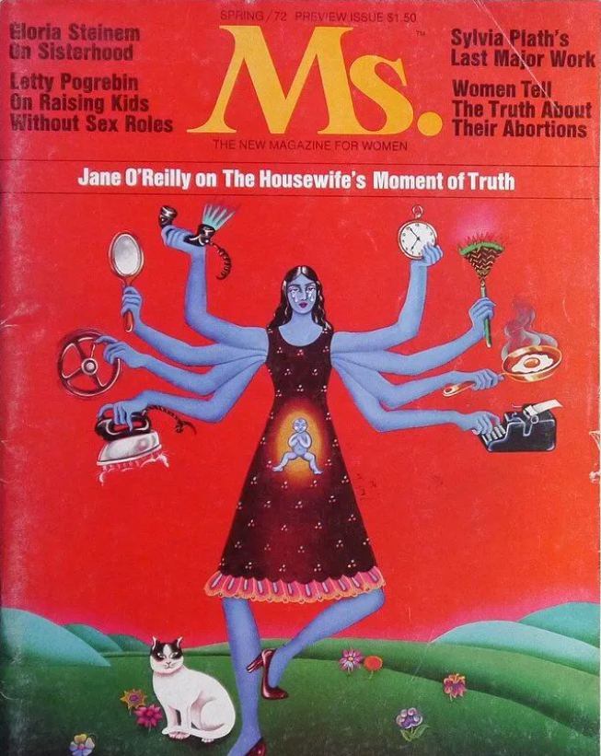
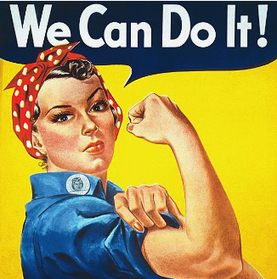
Second Wave
1963- Equal Pay Act
1965- Anti-discrimination laws
1963- Betty Friedan- The Feminine Mystique
1966- National Organization for Women
1972- Shirley Chisholm- Unbought and Unbossed
1972- ERA passed but ratified by only 35 states (38 needed)
1973- Roe V. Wade
1993- Family and Medical Leave Act
Notes:
WW-II- 16 million men were drafted and 6 million women were recruited to work in military factories- women can work as hard as men- second wave of feminism was born. While women were in the workforce- there were no laws protecting them. Could be openly discriminated against or paid less than men.
Women in 1930s worked, by 1950s- the traditional feminist ideal- Friedan came up with the idea at her college 15 year reunion in late 1950s- the problem with no name- women felt depressed- subjugated due to cultural gender roles, sexism- at work, home, church, educational institutions. But it was rejected to be published by any women’s magazine and she did extensive research and finally published it in 1963. Betty Friedan- opposed lesbian inclusion- later retracted- INTERSECTIONALITY
MYTHS associated with FEMINISTS ***ERA originally written by Alice Paul***

Slide 8
Third Wave
Inclusivity
Intersectionality
Previous waves- activists were white upper-class women; failed to address issues of women of color, low-income women or women living outside the U.S.
Rebecca Walker- in 1993- coined the term “third wave feminism” to create a more inclusive and comprehensive movement.

Slide 9
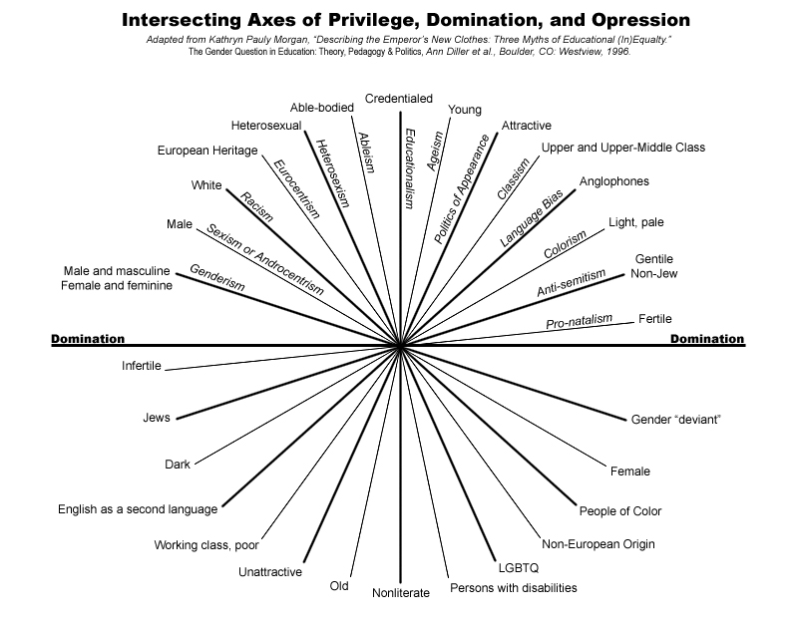

Slide 10
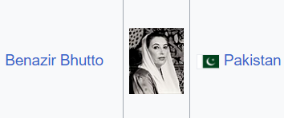
Growing up in India
Notes:
First elected female PM- Sri Lanka- 1960- Sirimavo Bhandarnaike
2 Presidents (Head of the State not Head of the Govt.): Pratibha Patil, Draupadi Murmu
Latest- Mexico
CAVEAT- I don’t mean to say that patriarchy was not as strongly entrenched in these Asian countries-Most of these women were wives/widows/daughters of powerful men. Yet, representation matters- the young girl growing up in India saw her country and several neighboring countries led by a woman. Representation matters!

Slide 11
Representation in Politics
Representation Matters!
Women leaders scrutinized at another level- looks, how they talk, not likeable, sexualization, motherhood, marital status, does not look presidential; smiles too little or too much!
The hardest Glass-ceiling!!
Notes:
Sarah Palin and Hillary Clinton

Slide 12
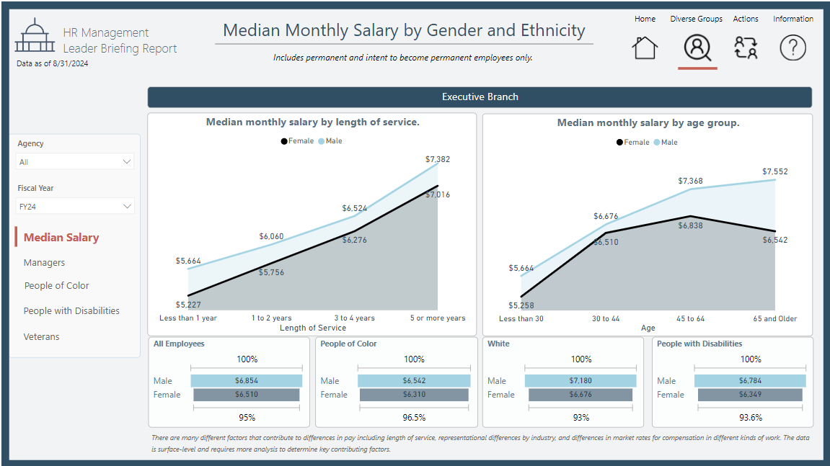

Slide 13
Gender Pay Gap
On an average, women make 84% of what men are paid working full-time.
In other words, women work from Jan. 1, 2023 to March 12, 2024 to make what men made in 2023.
March 12- Equal Pay Day
Source: U.S Dept. of Labor Blog
https://blog.dol.gov/2024/03/12/what-you-need-to-know-about-the-gender-wage-gap#:~:text=On%20average%2C%20women%20working%20full,full%2Dtime%20made%20in%202023.
Notes:
Motherhood penalty

Slide 14
Women’s work
First Shift
Second Shift
Third shift
Most modern couple start relatively equally but as they become parents, women’s responsibility towards household work solidifies as does men’s responsibility for wage-work.
Notes:
Second shift- domestic work;
Third Shift: ***OPEN CHAT**** Sandwich generation: caught between taking care of the elderly as well as the younger generation
Kin keeping: maintaining relations, remembering birthdays, entertaining, networking
Hand-out: Gender chores split, Gender Wage gap table; Housework study-https://www.ncbi.nlm.nih.gov/pmc/articles/PMC4242525/; Intersectionality

Slide 15
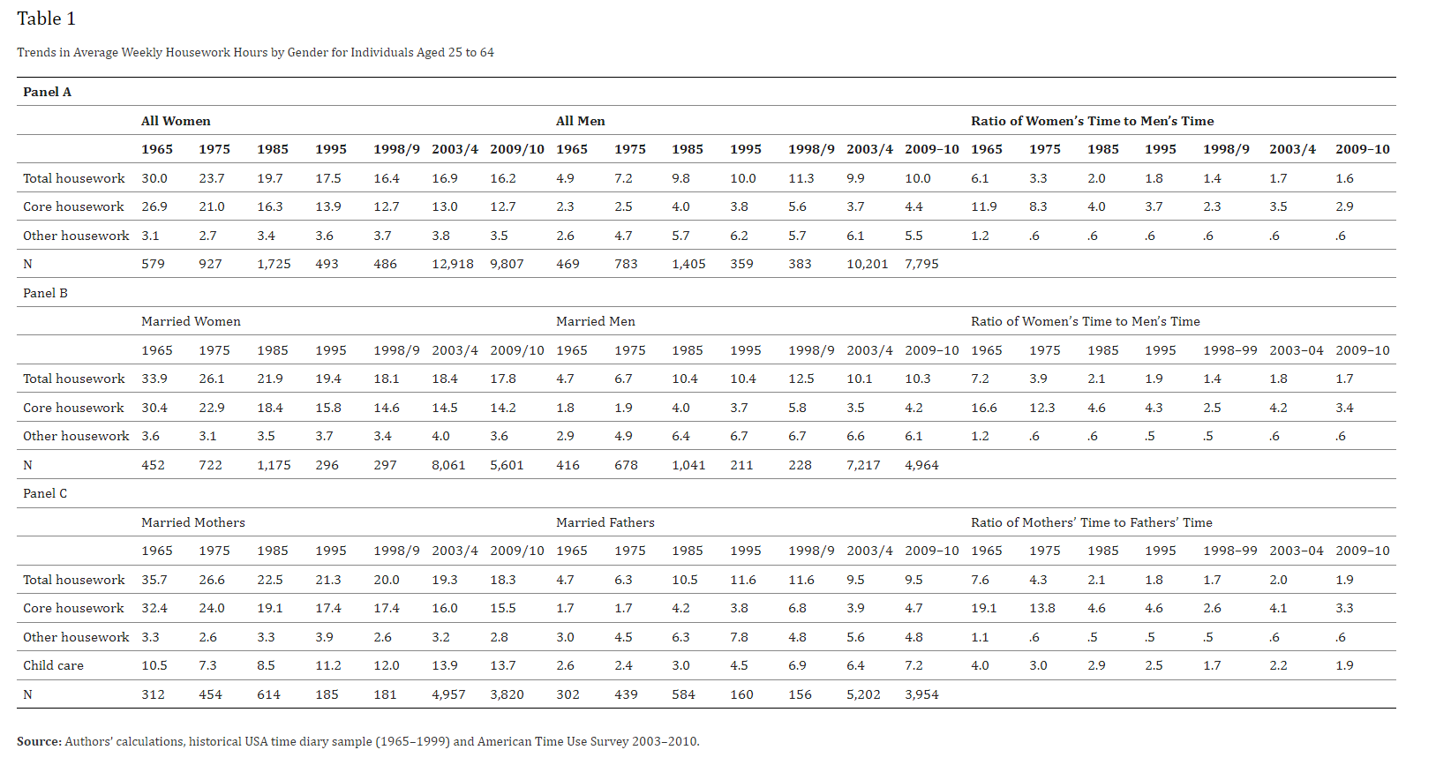
Source: Bianchi et al, “Housework: Who Did, Does or Will Do It, and How much Does It Matter?” https://www.ncbi.nlm.nih.gov/pmc/articles/PMC4242525/table/T1/?report=objectonly
Notes:
Children, machines, work is not getting done, other chores- bigger homes, home renovation projects

Slide 16
Who is doing the rest of the work?
CHILDREN?
MACHINES?
WORK IS NOT GETTING DONE!
OTHER CHORES- bigger homes, home improvement projects?
Notes:
Open chat

Slide 17
Impact of Multiple Roles on Mental Wellness- 2 Hypotheses
Role Enhancement hypothesis
Role Overload hypothesis
Multiple roles that women play- home, work, child-care shield women against pressures at home→ Better health, self esteem, satisfying work and low rates of depression
But of course, satisfying job and career are optimized when marriages are egalitarian and domestic responsibilities shared by spouses
Despite multiple roles, employed women are healthier and report feeling better about themselves than do full-time homemakers (Elger and Chester,2007; Pearson,2008)
Compared to men, women have fewer mental health advantages of multiple roles
First shift + second shift = Emotional distress (especially more for new mothers as compared to new fathers)
Other contributing factors (unique for each woman)- gender discrimination, stereotyping, sexual harassment
Notes:
Multiple roles and mental wellness- OPEN POLL! Which one resonates with you?

Slide 18
THANK YOU!
AMANDEEP.PURI@WSP.WA.GOV

