Slide 1
ICSEW July Transition and Celebration 2023

Slide 2
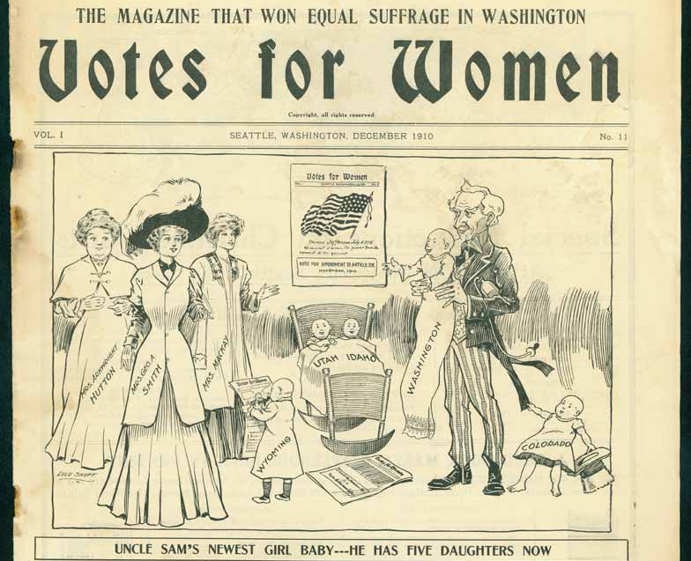
A look Back

Slide 3
Annual Report

Slide 4
Outstanding Subcommittee Members

Slide 5
Communications
Birgit Miller

Slide 6
Conference
Kristin Dugas

Slide 7
Legislative and Policy
Stephanie Goedecke

Slide 8
Membership
Jennifer Ward

Slide 9
Mentorship
Michelle Gladstone-Wade

Slide 10
Professional Development
Lyn Peters

Slide 11
Public Outreach
Sequenna Fashana

Slide 12
New Members since August 2022
Leia Althauser , Department of Fish and Wildlife
Julie Bagley , Department of Social and Health Services
Wendy Brand , Washington State Parks and Recreation Commission
Olivia Burley , Department of Veteran Affairs
Kristina Cox , Department of Health
Rocky Dimico , Department of Retirement Systems
Kristin Dugas-Asas , Department of Social and Health Services
Hannah Febach , Department of Health
Michelle Gladstone-Wade , Department of Commerce
Veronica Hand , Department of Fish and Wildlife
Colette Kinder , State Auditor's Office
Karen Martens , Department of Enterprise Services
Rachelle Martin , Department of Health
Stephanie Mason , Washington Medical Commission
Annie McHale , Washington State Parks and Recreation Commission
Alex Monroe , Washington State Parks and Recreation Commission
Keri Murphy , Washington State Parks and Recreation Commission
Hannah Ross , Washington State Parks and Recreation Commission
Jennifer Ross , Department of Health
Robin Rozene , Department of Veteran Affairs
Courtney Speer , Department of Enterprise Services
Te Young , Department of Health

Slide 13
Join us!
Current Vacancies:
Public Outreach Co-Chair
Membership Co-Chair
Contact: ICSEW@OFM.WA.GOV

Slide 14
Executive Board

Slide 15
Welcome!
Alyssa Woods - Secretary
Kaitlin Nielsen - Treasurer
Danica Mitchell - Treasurer

Slide 16
Chair | Deirdre Bissonnette
Vice Chair | Marianne McIntosh
Treasurer | Kaitlin Nielsen Danica Mitchell
Executive Secretary | Sequenna Fashana Alyssa Woods

Slide 17
Subcommittee Chairs
Communications Co-Chairs | Rachel Friederich Rebecca LaMar
Legislative & Policy Co-Chairs | Leslie Wolff Keri O’Connell
Membership Chair | Siri Olsen
Mentorship Workgroup Co-Chairs | Masozi Nyirenda Courtney Speer
Professional Development Co-Chairs | Connie Becker Janet McIntosh
Public Outreach Chair | Brooke Nutt
Conference Co-Chairs | Kassandra Drake Summer Ramos
Special Projects | Allison Spector

Slide 18
Leadership
Keri O’Connell
This award is given to an outstanding leader. The recipient demonstrates courage in making leadership decisions, excellence in professionalism and actively assists others in realizing their potential.

Slide 19
Everlasting
Ann Bartholomew
The recipient of the Everlasting Award remains calm under pressure and handles changes in leadership with resilience. This representative also retains and shares a wealth of historical information and assists others at all times.

Slide 20
Visionary
Masozi Nyirenda
This award recognizes a committee member who helps see out future and helps us get there. The recipient demonstrates innovation and constantly implements new ideas.

Slide 21
Lorrie Brown
Summer Ramos & Kassandra Drake
This award honors someone who demonstrates innovative problem solving and excellence in public service. It is named after the late Lorrie Jo Brown. During her service with ICSEW, Lorrie Jo Brown played an instrumental role in the committee’s breastfeeding survey project and in mentoring others.

Slide 22
Extra Mile
Janet McIntosh
The recipient of this award has gone above and beyond to serve the ICSEW’s mission. The recipient demonstrates an outstanding effort on committee work and activities and commits time and energy to enrich lives though advocacy, outreach and opportunity.

