Slide 1
Activate Support to Accomplish Goals
ICSEW Annual Meeting
March 21, 2023
Wendy Fraser, PhD

Slide 2
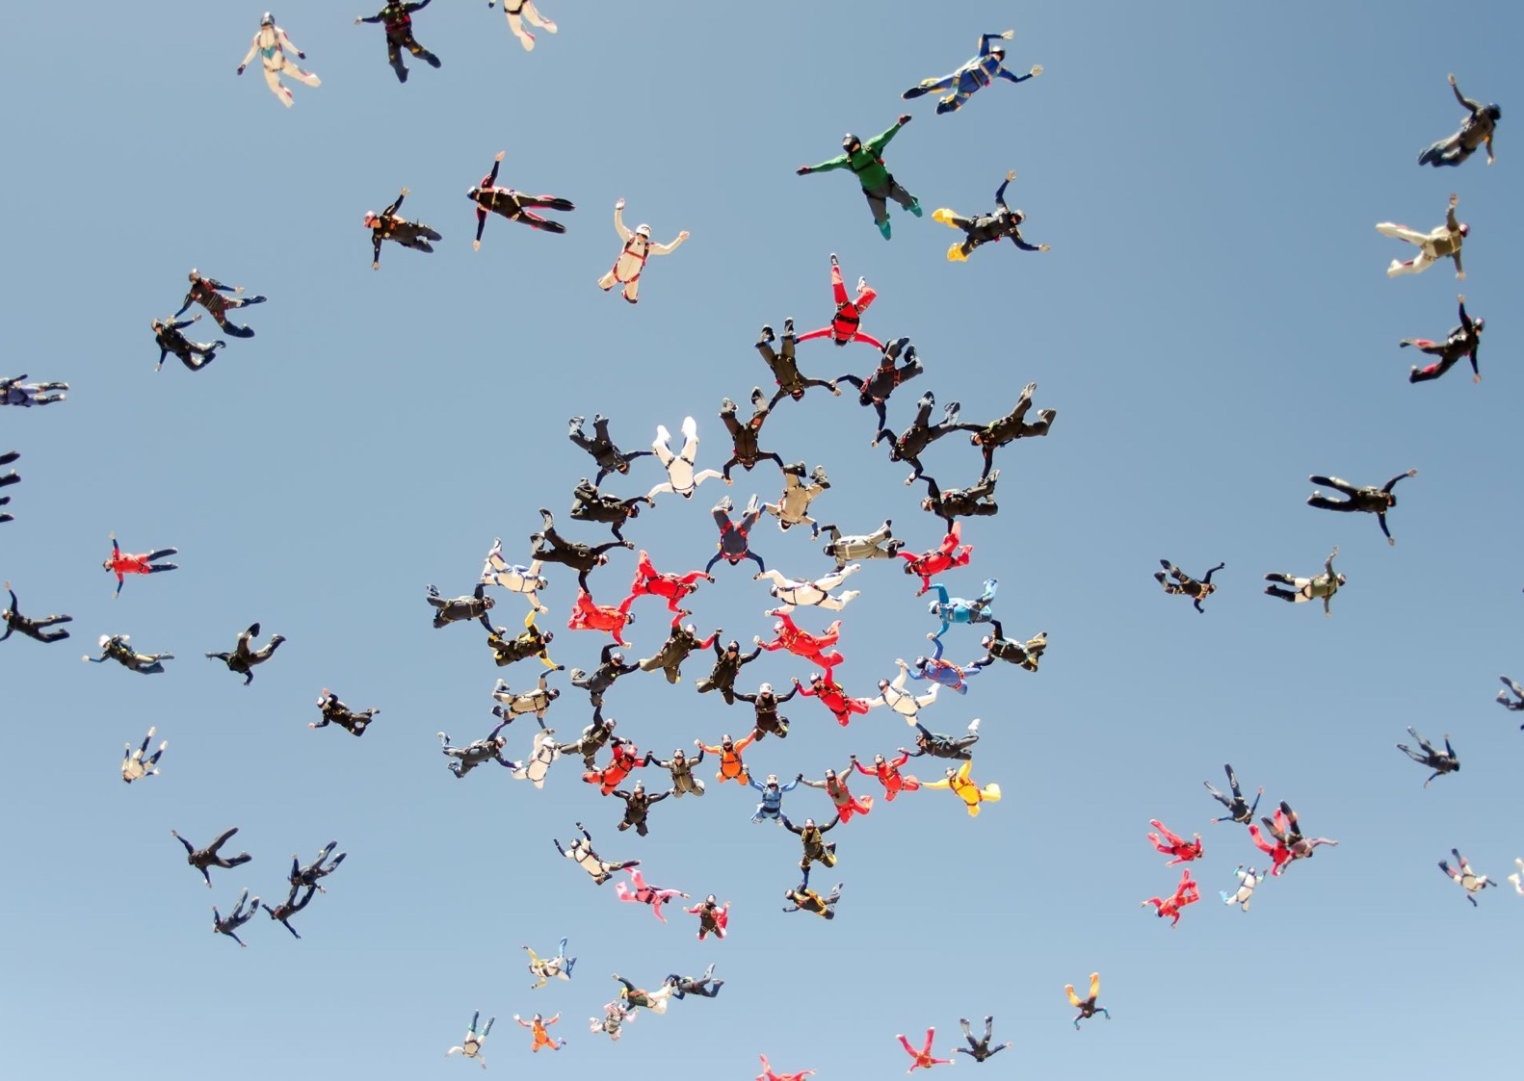
Learning Objectives
Reflect on the current role of support systems in our lives and the beliefs that impact our use of support systems.
Better understand the role of support systems in achieving professional goals.
Develop a plan to contract for support needed for a goal.
Notes:
The practice of asking for support is often viewed as weakness or we are conditioned to believe we have to handle things ourselves. This thinking is harmful and can lead to burnout. We will explore different types of support and how to activate those to help us achieve personal and professional goals.

Slide 3
Oxytocin – social bonding chemical is released when people help others
Notes:
US Americans and Alaskans in particular have a strong belief in self-reliance.
Always willing to offer support but we do not often ask for support.
Truth is we seldom do anything without support.
Brain research: Oxytocin (social bonding chemical) is released when people are able to help others.
Do you over-say “yes” when others ask you for help?
Consider your patterns in personal or professional settings when and if you ask for support.

Slide 4
Small Group Conversations
Reflect on:
Think of a time that you needed support for something you wanted to accomplish? What did you do about it?
Answer in small groups:
What are your beliefs that guide your behavior about getting support for yourself?
Notes:
Breakout rooms – 50 rooms; up to 4 people
Introduce Interpersonal Dynamics Model: Intention, Connection, Ego Management
Personal story about support:
My automatic is to say no, I can do it
When I choose to examine my support system

Slide 5
Why do we think we have to navigate things on our own?
Notes:
We feel good when we support others. Why not let others feel good when they support us?
Facilitators’ notes:
Our socialization may include a belief that we can’t rely on others’ support, I can’t trust that it will happen for me, or I should be able to do it on my own. The question is, are these beliefs working for you? Would it be useful if you had a choice?
A support system can grow out of a simple conversation.

Slide 6
Reframe: Activating Support is a Source of Strength and Strategy
Goals are seldom accomplished without support.
Personal support systems can help us avoid burnout.
Personal support systems can help us achieve more than we ever imagined.
A support system is a resource pool drawn on selectively to support me in moving in a direction of my choice and which leaves me stronger.
Notes:
Goals are seldom accomplished without support
Personal support systems can help us avoid burnout.
Personal support systems can help us achieve more than we ever imagined.
A support system is a resource pool drawn on selectively to support me in moving in a direction of my choice and which leaves me stronger.

Slide 7
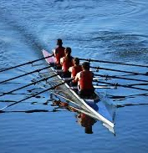
Support looks like a lot of things…

Slide 8
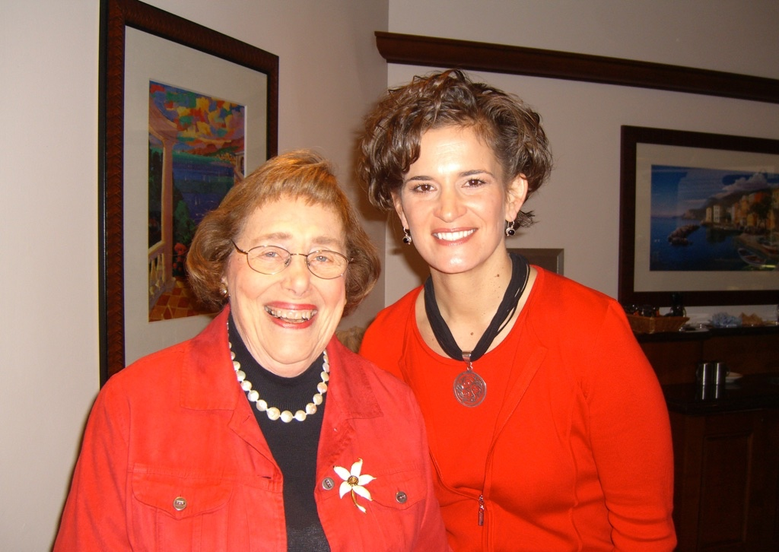
Role Models
People whom you admire, respect, see as competent and confident. People who serve as an example of you "would like to be like" in one or many respects.

Slide 9
Common Interest
People who share your concerns because "they are in the same boat." People who strive for similar goals and with whom you share interest, experiences, and concerns.

Slide 10
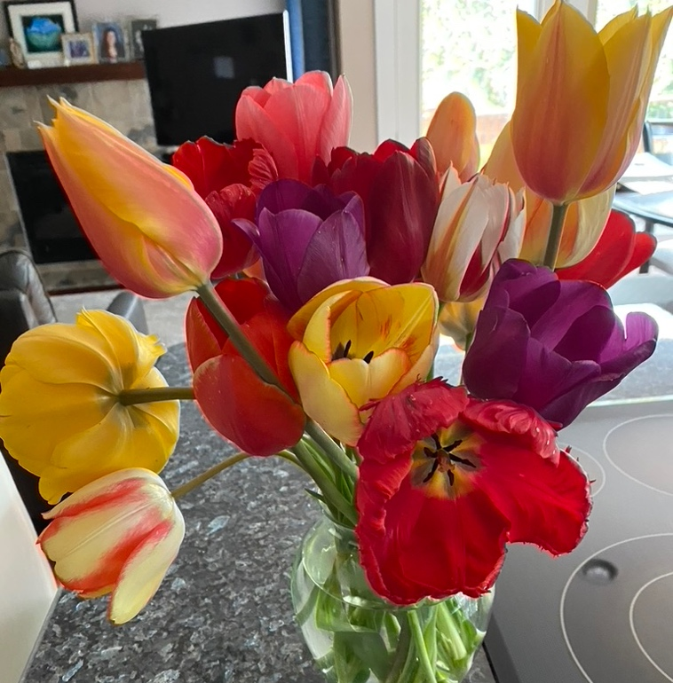
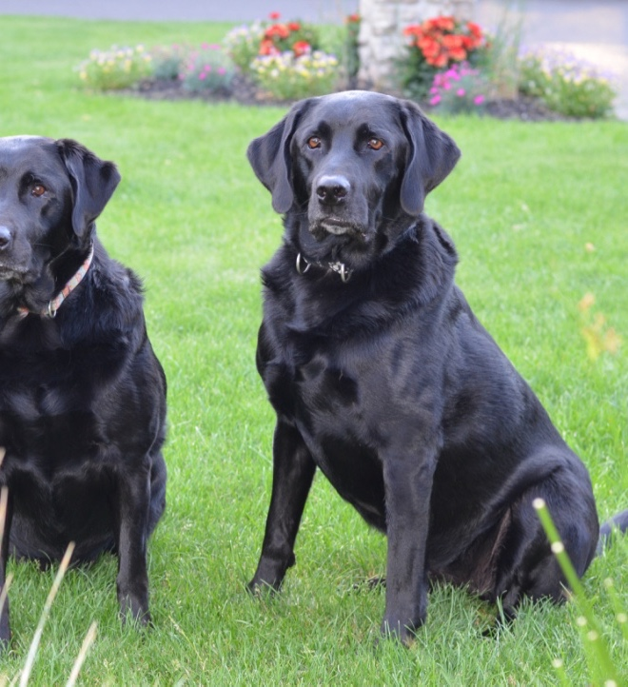
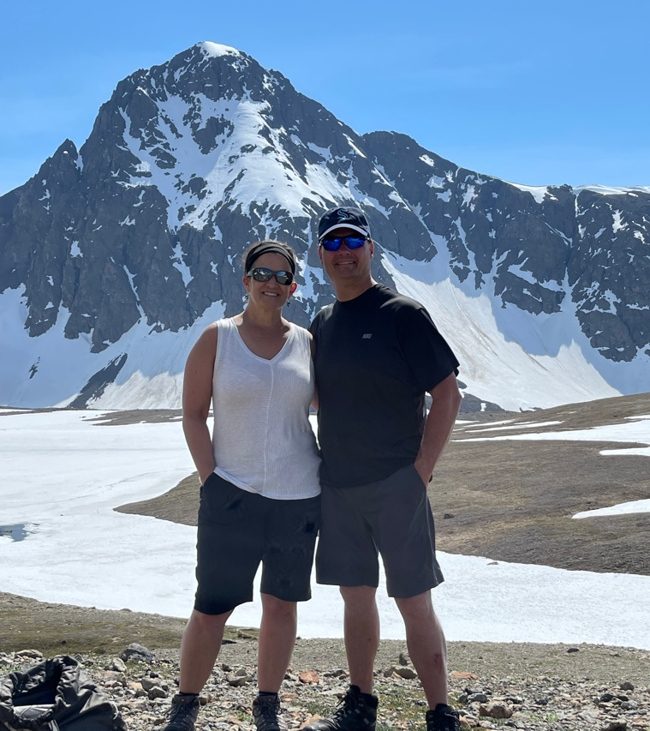
Relaxers
People or non-human supports (e.g., pets, music, hobbies, exercise) who help you relax.
Animals, music, exercise, technology, books, nature, and hobbies can be an important part of your support system. Keep them in mind as you assess what you have and what is missing.

Slide 11
Dependables
Those who provide personal assistance and always seem to be willing to help when you have a need. People who can be relied upon in a crisis.

Slide 12
Respecters
People who respect your competence and who understand the difficulty and value of your work. People whom you respect, that recognize your skills and give you self-worth.

Slide 13
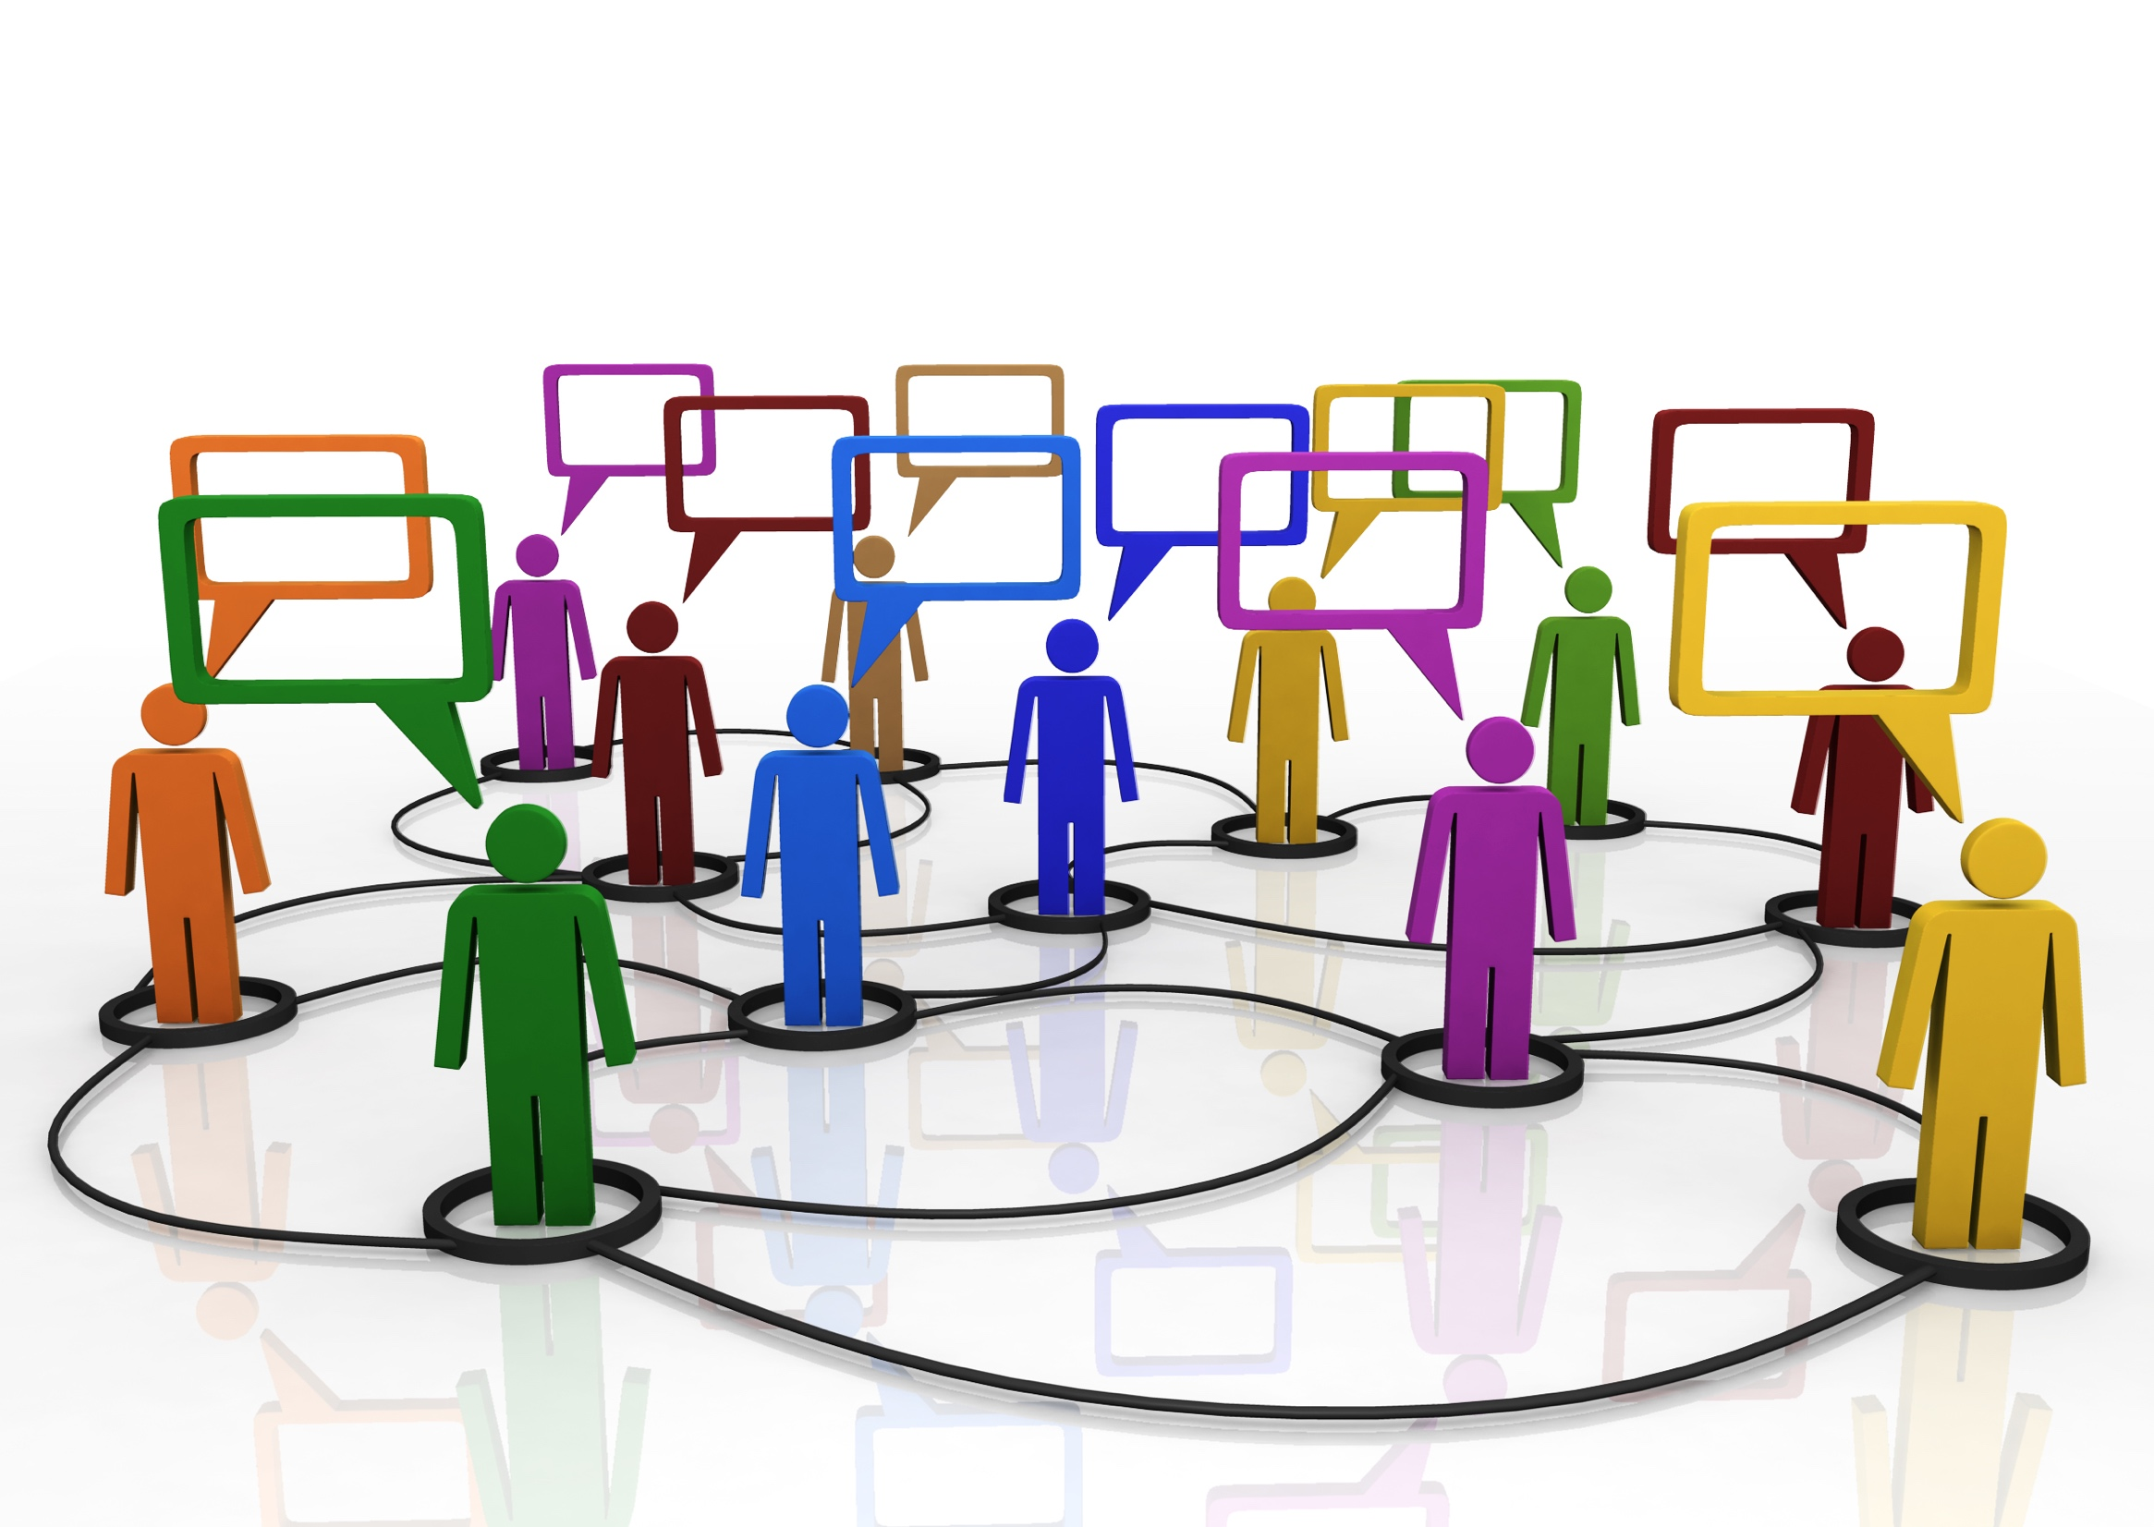
Referral Agents
People who open doors, put in a good word, and recommend the right people, to help you fulfill your needs.

Slide 14
Challengers
People who challenge your basic assumptions and working principles, provide other perspectives and ask you things you haven't considered. People who stretch you, encourage you to move in new directions, and to continue to grow.

Slide 15
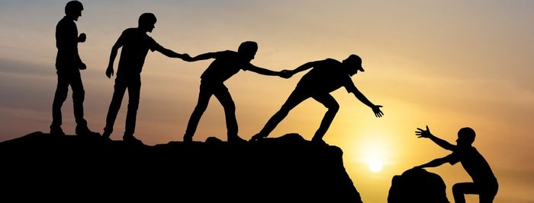
Guides
People who have “been there, done that” and can provide you with advice and share their wisdom. People who boost your confidence to take your next steps to achieve your goals.

Slide 16
Review the names in your support system
Do you have a strong support system? Where are you missing support?
Do you have one individual in three or more categories? Are you overly reliant on this person?

Slide 17
Different Experiences Need Different Support
Experience | Support Type | Outcome
Confusion | Role Models | Clarity
Isolation | Common Interest | Social Contacts
Stress | Relaxer | Renewed
In Crisis | Dependable | Supported
Low Self-Esteem | Respecter | Affirmed
Disconnection | Referral Agents | Connections
Plateau | Challengers | Cutting Edge
Uncertainty | Guides | Confidence

Slide 18
Building Professional Support Systems
Reflect on a professional goal.
Use the worksheet to identify the types of support you need. Write names or groups down.
Get support – Share your intentions and ask for what you need
Engage in the discussion – it’s okay for people to say no, or not right now, or offer alternatives. You don’t have to accept it. Stay in the discussion.
Notes:
Write a goal on the top of your sheet. Think about all the people and groups who can help you and support you with this goal. What are your next steps?

Slide 19
Activating Healthy Support Systems is a tool, a strategy, and a must! Any questions?

