Slide 1
Washington State Department of Health
Office of Public Health Outbreak Coordination, Informatics, and Surveillance

Slide 2
Overview of today’s discussion
Successes of PHOCIS so far
Rapid Workforce Establishment
Expanding Public Health Capacity
Highlighting Women in PHOCIS Leadership positions
What’s next for PHOCIS and Public Health?
Stand-up of new data system capabilities

Slide 3
PHOCIS Success Stories

Slide 4
Workforce Establishment
Established generic job descriptions
Recruited over 400+ employees into public health
Stood up rapid-interview processes
Developed internal sharepoint and training practices for rapid onboarding

Slide 5
Advanced Decade Old Systems
Data exchange- new and novel approaches (i.e. Simple Report)
Contact tracing and investigation data capture and interview technology (i.e. CREST)
Rapid survey assessment tools (i.e. REDCap)
Digital Tools for public use during various phases of non-pharmaceutical interventions (i.e. WANotify and WAVerify)

Slide 6
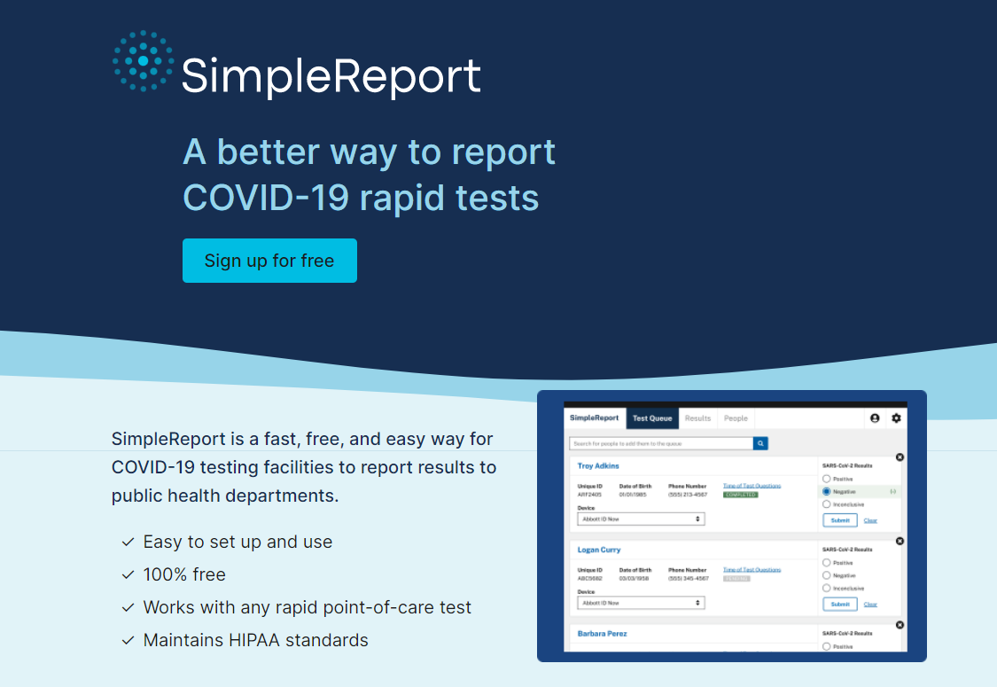
Simplereport.org – Covid reporting site available to public
Individuals are able to self report OTC (Over the counter) tests
Testing Facilities, Hospitals, and Long-Term Care Facilities also are able to report their collective numbers
Over 2,000 partner organizations are reporting in Washington
Privatized Data to Maintain Security

Slide 7
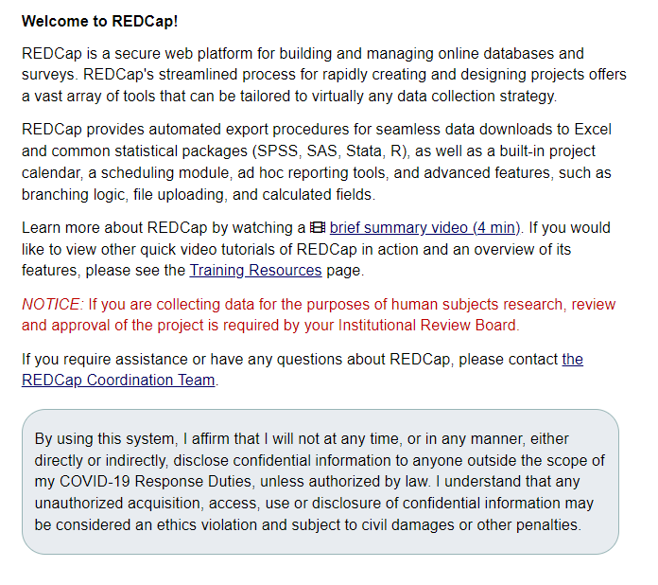
REDCap –
Build online surveys and databases quickly and securely
Advanced instrumental design features
Diverse distribution options
Custom reporting and high data quality
Export Data to common analysis packages (PDF, CSV, etc)
Data based triggers and alerts

Slide 8
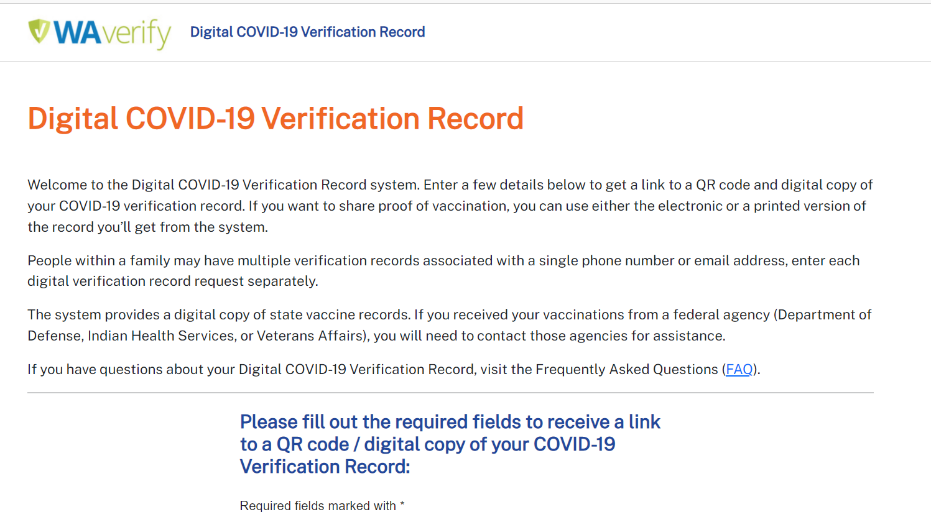
WA Verify – Digital COVID-19 Vaccination Verification Record
Allowed for discreet, data safe, travel friendly means to verify confirmation of vaccination
QR Code available for ease of scanning via mobile device
Securely stored in ways to protect personal privacy

Slide 9
New Capacity
Testing
Case Investigators
Surge staffing supports
Broad data science informatics capabilities

Slide 10
Say yes to covid-test –
Free Over the Counter Tests for all homes in Washington State, available on a monthly basis via web-based portal
Separate from State and Federal Distribution
Stood up at the peak of Omicron outbreak
Distributed over 1.5 million test to individual homes

Slide 11
Challenges

Slide 12
PHOCIS Challenges to Overcome
Global Pandemic: relying on historical knowledge and plans that have only been exercised to set the tempo for response
Shifting strategies for non-pharmaceutical interventions as new scientific understandings became clear
Often led to new ways of approaching work or targeting existing strategies
Evolving shortages and increasing waves of disease disproportionately impacting our communities
Introduction of pharmaceutical interventions led to new ways of navigating work and resource needs
Public perception and public trust

Slide 13
Celebrating the women who made PHOCIS possible!

Slide 14
“What drew you to PHOCIS?”
“I saw an opportunity to make a difference… I believe the work being done in the PHOCIS office aligns with DOH;s mission statement perfectly, we are helping the people of Washington stay healthier!”
“The work and the people… I wanted to be part of a great team who is passionate about working together for a positive impact in our community… Responding to COVID was challenging no doubt, everyone worked together, supported one another, and faced those challenges as a team.”
“Being able to fill long term needed gap around support and being part of the COVID response”
“I was hoping to find a position where I could do something that had meaning and served the community. I was lucky to have found the place”

Slide 15
What are you most proud of accomplishing at PHOCIS?
- “Building a great, professional, independent, competent, close-knit team. Working for PHOCIS and DOH has given me a better understanding of who I want to be… and get over my own fears!”
- “Building from scratch, hiring & onboarding the best team of professionals I have ever worked with. The team work accomplished through response work – even though we might not know what that is week from week”
- “I am most proud of the resilient and positive team… Hundreds of thousands of people were contacted, supported, and offered additional resources”
- “The accomplishment that I’m most proud of would be creating a positive office culture. Although, we work hard, we’ve still managed to incorporate fun into our days, which is why I think that our work has been successful.”

Slide 16
How do you approach leadership with your team?
“Ready to serve, compassion, honesty and having fun. Asking good questions – what does the team need to be successful and how can my leadership help facilitate that?”
“I approach leadership by being a supportive and empowering leader as well as building relationships and trust. I want everyone on my team to feel supported to make decisions and lead their teams but know that I am here to guide them through challenges and clear roadblocks when needed.”
“Trust. It can be hard to let go, and it can be tempting to micromanage. You don’t have to know everything about everything your team is doing. As long as you as a manager are not getting complaints, they must be doing something right! Always, keep your door open and always be available… Most important part of being a leader is giving your staff what they need to do their job and focus on the professional development beyond their current position. If they succeed, you succeed!”
“I approach leadership with my team by being of a coach and mentor. I’m fortunate to have a team of highly capable individuals that love what they do! I make sure that I’m there to support them in all capacities. I lead with empathy, transparency, and provide them with a safe space for crucial conversations.”

Slide 17
The last 2 years of this Global Pandemic have been hard on us all both personally and professionally.
It has changed our business practices
It has challenged us to think of new approaches to our work
It has impacted our families, friends and communities
We would like to have a small breakout room time for us to collectively share or reflect (for those not in a space to share) on one thing that you have done or another has done to make these last two years just a little easier.

Slide 18
The Future of PHOCIS and Covid Response
Increasing sustainability in response approach – continual position of reimagining expanded scope
Developing comprehensive and collaborative strategy with Tribal and Local Health Jurisdictions to optimize data management and cohesion
Expanding beyond Covid, using lessons, tools and strategies learned to implement with the future of Covid as well as other inevitable pandemics.

Slide 19
Thank you
Cynthia Harry (cynthia.harry@doh.wa.gov) & Mike Boysun (mike.boysun@doh.wa.gov)

