Slide 1
Hope Inspired Leadership
Using the science of hope to build and lead effective teams

Slide 2
Hope matters Hope is a skill Hope is universal Hope is a choice
Hope is a Strategy

Slide 3
What does it mean to be hopeful?
Thinking about the future
Optimism v. Hope
Hope Theory
Notes:
Hope is the belief that we can create a better future
Hope is a theory of positive change
Goal Driven
Strategic Thinkers
Problem Solvers
Growth minded (never satisfied with the status quo)

Slide 4
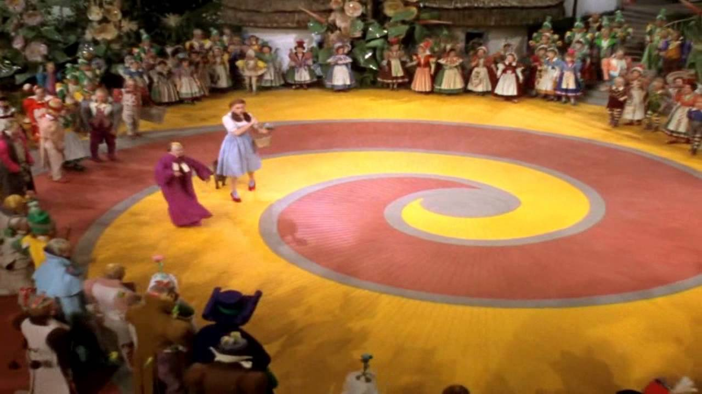
Pathways (Waypower)
Expectation for GOAL acheivement
Agency (Willpower)
Notes:
Dorothy now has a goal (there’s no place like home} and a sub-goal (we’re off to see the wizard). She also has a pathway (follow the yellow brick road) and the agency.

Slide 5
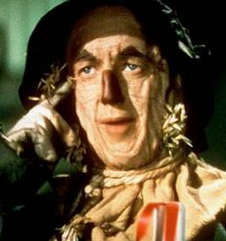
GOALS PATHWAYS AGENCY
Hope is a way
of thinking…
Notes:
Cognitive process – not emotional
Universal - No correlation between hope and intelligence, gender, etc.
Can be taught and learned
Contagious

Slide 6
Collective Hope…
Notes:
Set up the scene – The Wizard of Oz
A group of people working together to achieve a common goal – A TEAM!

Slide 7
Collective Hope…
…The Foundation of a Team
Notes:
Shared goals (or sub-goals)
Shared belief that goals are achievable
Collaboratively create strategies (pathways)
Shared motivation and willpower
Common belief that goals are achievable
Collective hope is the foundation of a team

Slide 8
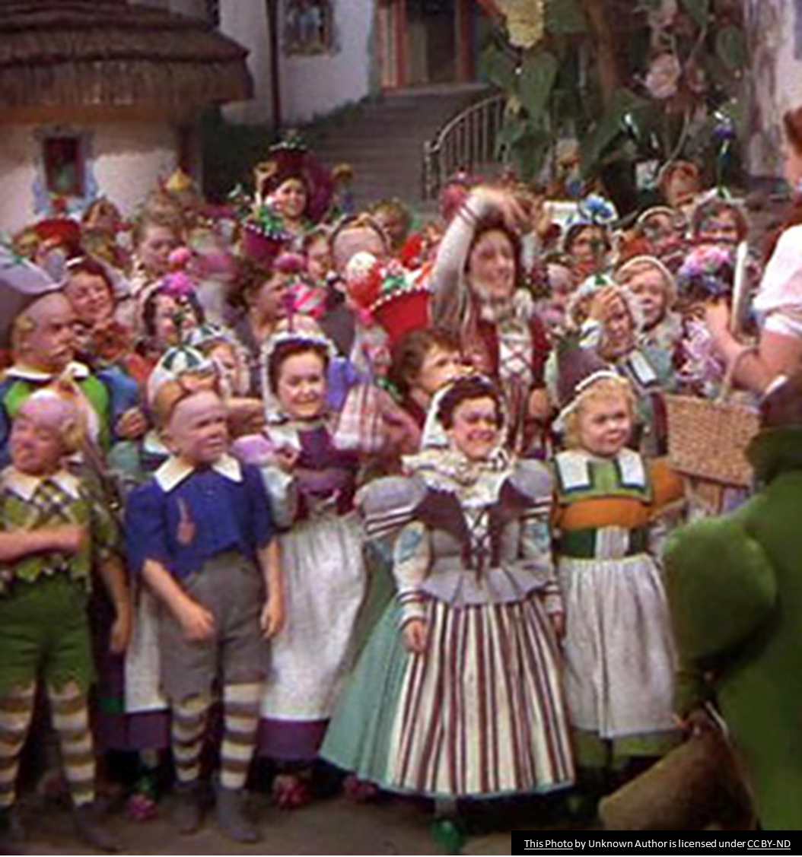
Hope is a social gift we give each other

Slide 9
Measuring Hope
Adult Hope Scale – developed by Dr. Rick Snyder
Collective Hope Scale – developed by Dr. Chan Hellman

Slide 10
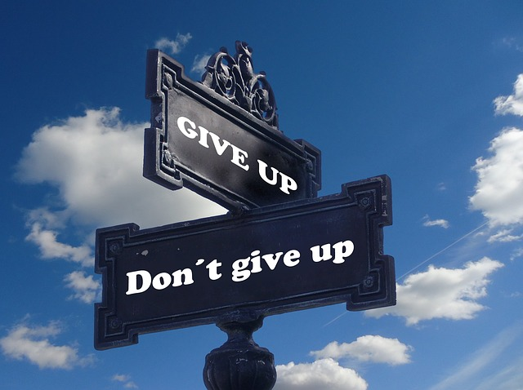
Markers
The words we use are clues to our hope
Notes:
There are ways to evaluate the hope of others without using the hope scale…
Listen to what they say.

Slide 11
The Power of Hope
Work
Lower unplanned absences (4x)
Higher productivity (1 day/week)
More open to organizational change
Reach goals more often and sooner
More resilient to stress, vicarious trauma and compassion fatigue
Higher profits and lower employee turnover
Education
Higher academic performance
Best predictor of success in college
Health
Increased health
Higher pain tolerance
Lower depression
Longer Lifespan
Hope is a leading predictor of Happiness and Wellbeing

Slide 12
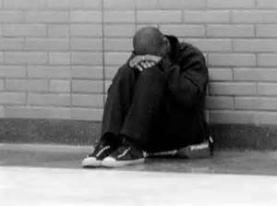
Hopelessness
HOPE
Anger
Emotional reaction when goal is profoundly blocked
Despair
Overwhelming sense of futility
Apathy (Hopeless)
Complete loss of motivation
Notes:
Markers for hopelessness
Hope (agency) is a depletable resource
Anger response is rooted in fear of failure, inability to achieve the desired goal.
Despair is like grieving the loss of the goal
Apathy is a complete loss of interest in the goal (or the future for that matter).

Slide 13
You hold the power of hope in your hands

Slide 14
Hope Inspired Leadership
Hope
Centered
Servant
Based
Culture Focused
Notes:
The Three principals of Hope Inspired Leadership.
The first focuses on the leader
The second focuses on the followers
The third focuses on the team (i.e. mission, vision goals, etc)

Slide 15
What do people want most from their leaders?
Compassion
Trust
Stability
Hope
Notes:
How does hope apply to leadership
None of these items have anything to do with position.
True leadership has nothing to do with position or authority
Remember – Dorothy is a servant-based leader

Slide 16
“Hope… it is the only thing stronger than fear”
Notes:
President Snow recognizes that Hope is stronger than fear.
The irony is he is a power based (fear) leader
Katniss is a hope-based leader

Slide 17
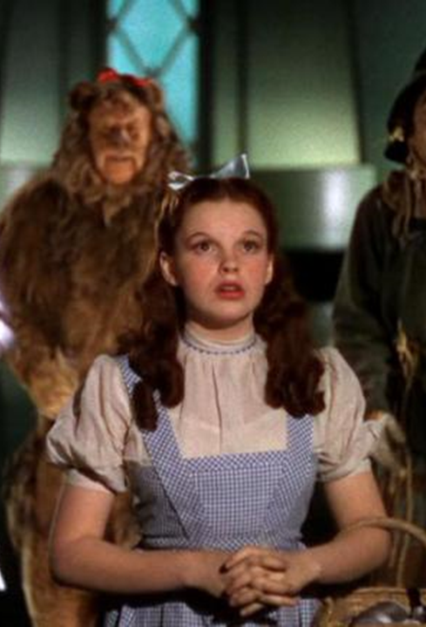
Servant Leadership
Lead through influence
Influence through relationships
Build Trust
Listen
Support hope
Empower
Be courageous
Celebrate achievements
Notes:
Who’s the Leader?
What makes Dorothy the leader?
What is a servant leader?

Slide 18
Modeling Hope
Make hope a personal philosophy
Be optimistic
Be goal driven
Think strategically
Solve problems
Let your hope infect others
Notes:
Think about someone who makes you hopeful.
Recognize you can influence the hope of others.
Be authentically hopeful

Slide 19
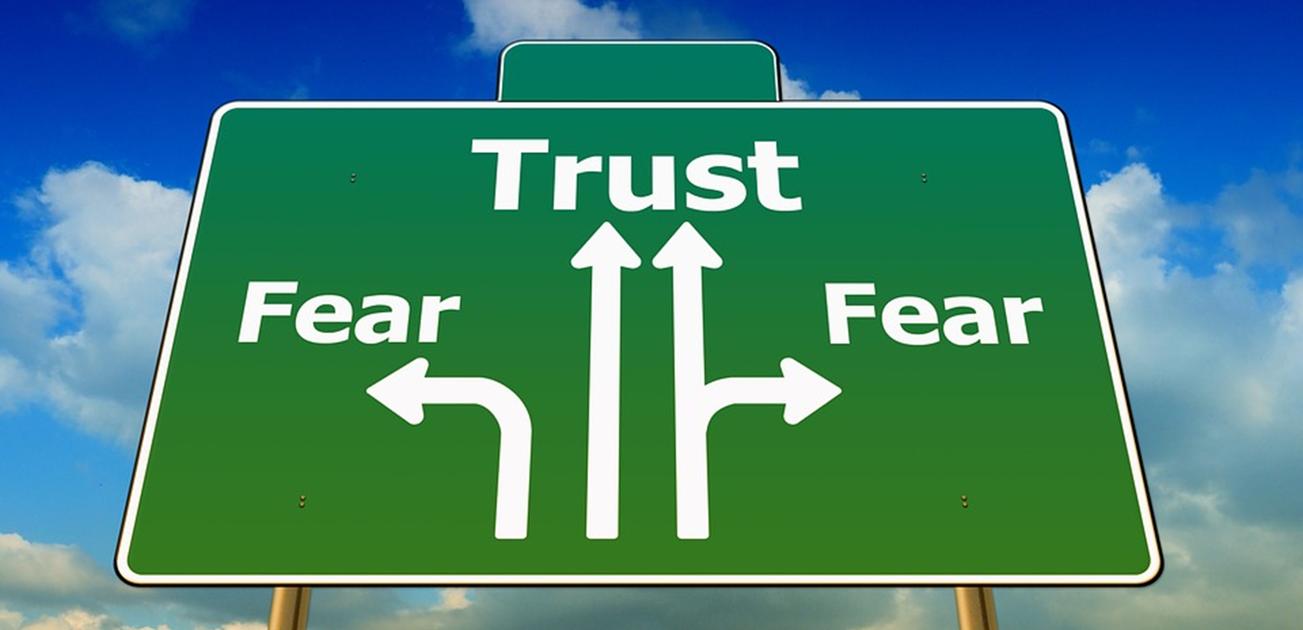
Culture Focused

Slide 20
Culture Focused
Engagement, Wellbeing, Satisfaction, Resilience, Performance, Retention
Hope
Trust, Support, Honesty,
Courage, Compassion, Forgiveness
Nostalgia
Optimism
Organizational Culture
Past
Memory
Imagination
Future
Distrust, Instability, Dishonesty, Bullying, Blaming, Gossip
Rumination
Pessimism & Worry
Fear
Stress, Conflict, Burnout, Disengagement, Absenteeism, Turnover
Notes:
Fear includes a constant fear of failure, what the future may bring, or just the future will never get better.

Slide 21
Building Hopeful Culture
Pay attention to markers
Teach and use hope framework
Make hope a valued strength
Leverage the contagiousness of hope
Promote strategic thinking and problem solving
Celebrate achievement

Slide 22
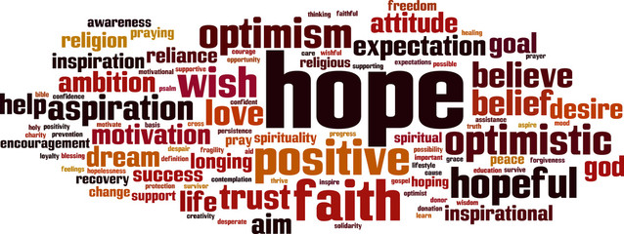
Hope Centered

Slide 23
Building Hope
HOPE
Goal Achievement
Pathways
Agency
Goals
Thinking about a better future
Creating Future Memories
(Time Traveling)
Notes:
Click on GOAL SETTING for goal setting exercise
Click on PATHWAYS for pathway exercise

Slide 24
Goals “Begin with the end in mind” -Stephen Covey
Goals are most motivating when they are both desirable and achievable.
Notes:
In looking at goals, consider
Achievement v. avoidance
Avoidance goals are rooted in fear and will have limited motivation
Achievement goals are rooted in achievement and a motivating over a longer time
Time: Infinite, distal and proximate
SMART GOALS
Its all about desirable and achievable to the goal setter
i.E can’t make your goal their goal

Slide 25
Pathways
Determine sub-goals
Brainstorm pathways/strategies to connect sub-goals
Identify barriers that currently exist or may arise
Brainstorm solutions to barriers
Select pathway which provides the highest likelihood of success

Slide 26
Agency
Self-Efficacy
Courage
Zest
Grit
Notes:
Self Efficacy - “The belief in one's capabilities to organize and execute the courses of action required to manage prospective situations.“
Courage - The willingness to face adversity even when fearful. This allows us to take risks when chasing goals.
Zest – (component of courage) Enthusiasm for life. Our source of energy.
Grit – Passion and perseverance toward long term goals (Angela Duckworth)

Slide 27
Building Organizational Hope
Collective Hope
Common Pathways
Agency
Common Goals
Mission
(Why Statement)
Vision
(Create Future Memory)

Slide 28
Hope Centered
Purpose, Mission, Values
Vision
Infinite Goals
Strategic Goals
Pathway
Sub- Goal
Pathway
Sub- Goal
Pathway
Pathway
Sub- Goal
Pathway
Sub- Goal
Pathway
Pathway
Sub- Goal
Pathway
Sub- Goal
Pathway
Agency
Notes:
The final step of building collective hope is alignment
Lencioni calls this organizational health
Common Goals, Common Pathways, Shared Agency
Strategic planning

Slide 29
While there is life, there is hope…
Notes:
Stephen Hawking spent his career looking for the Theory of Everything in physics
Turns out the Theory of Everything in life is hope

Slide 30
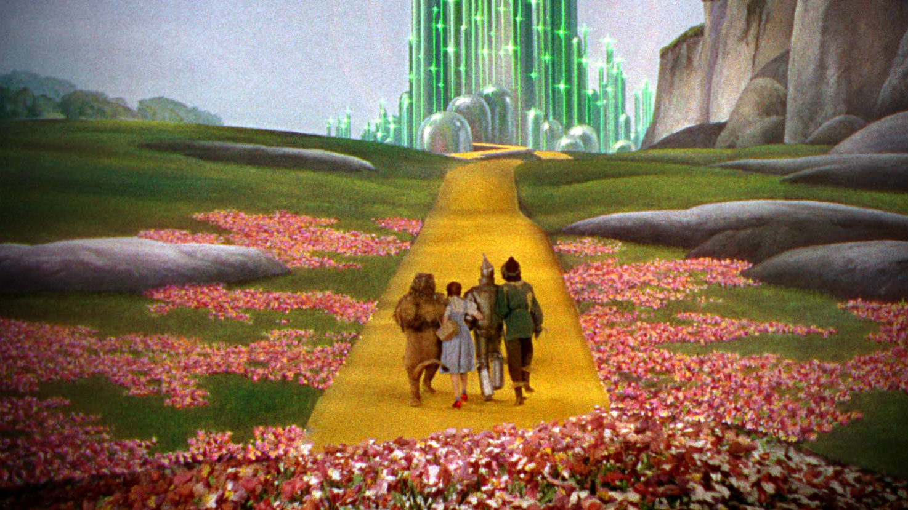
“Everything that is done in the world is done by hope”
Martin Luther
Notes:
Hope is what drives us to achieve our goals.
It is the ultimate skill that allows us to achieve our goals.
Hope is a strategy.

Slide 31
Contact Information
Jon Tunheim , Thurston County Prosecuting Attorney
Email: jon.tunheim@co.thurston.wa.us
Phone: (360) 786-5540

